Slide 1
Towards Rapid Interactive Machine Learning: Classification without Representation
Dustin Arendt¹
Emily Saldanha¹, Ryan Wesslen²,
Svitlana Volkova¹, Wenwen Dou²
Presented at ACM IUI 2019, March 19, 2019
1: Pacific Northwest National Laboratory
2: University of North Carolina at Charlotte
Notes:
What is classification w/out representation
What is CHISSL
What is interactive machine learning?
What do I mean by scale (visible, fast interaction, many users simultaneously)?

Slide 2




Necessity of Large, High-Quality, Labeled Datasets: Machine Learning’s “Elephant in the Room”
Because, crowdsourcing requires
A well defined task
Users with expertise
A large population
Alternatives may not be satisfying
Active Learning
Visual Interactive Labeling
What we need
Rapid model feedback
Doesn’t overwhelm or over-constrain
Facilitate data exploration, flexible classes

Slide 3
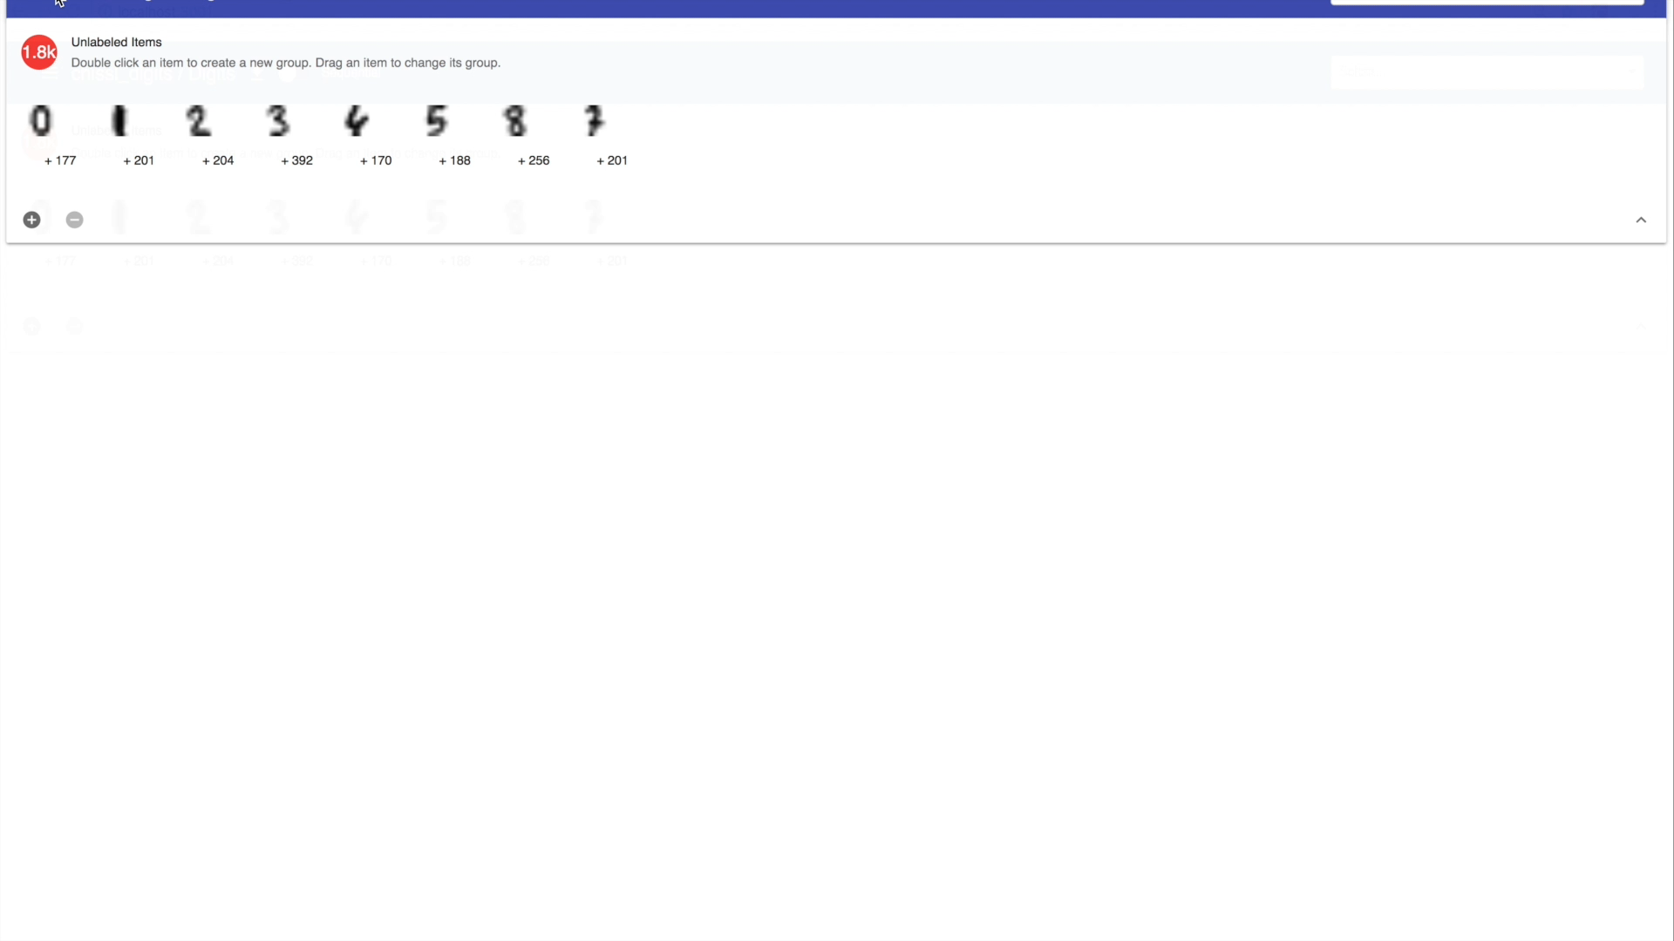
CHISSL—Rapidly Organize Data and Build Models

Slide 4
Summary CHISSL’s Advantages
Intuitive
Drag and drop examples to define groups and correct the model
Data is organized in simple table, rows are classes, columns are types of examples
Flexible
Doesn’t require knowledge of classes a priori
Adaptable to different data types
Custom interactive visualizations
Scalable
Re-train at interactive speeds for large datasets
Tip of the iceberg design shows a small number of relevant instances

Slide 5
Design Constraints Based on Threats to Scalability
Computational Constraints
Don’t fit/predict on server
Latency
Surging Demand
Don’t send representations to client
Load time
Browser memory
Visual Constraints
Don’t aggregate instances
Over-abstraction
Over-specialization
Don’t show every instance
Clutter
Over-plotting

Slide 6
How does CHISSL work?

Slide 7
Supervised vs Semi Supervised Learning Induction vs Transduction Learning
Training
After Training
Labeled Data
New Data
?
Instances
Labels
The model guesses these
Unlabeled Data
?
More Instances
We don’t know these

Slide 8
Representation Free Classification
Semi-Supervised Transduction Learning
Representation-Free Transduction Learning
Labeled Data
Labeled Data
!!!
Unlabeled Data
?
Unlabeled Data
?

Slide 9
Secret Sauce: how to find a good
!!!
Hierarchical clustering
1-NN classification
Dynamic programming
Parent Pointer Array
Advantages
O(n) space complexity
O(n) time complexity
Incremental
Stable
Limitations
Transduction learning
Depends on a good clustering
4
5
?
A
B
A
A
A
B

Slide 10
CHISSL Induction: “I can’t believe this actually worked”
Training
After Training
Labeled Data
!!!
New Data
?
The model guesses these
Unlabeled Data
?
See also: High-Fidelity Image Generation With Fewer Labels
https://arxiv.org/pdf/1903.02271.pdf

Slide 11
How well does CHISSL work?

Slide 12
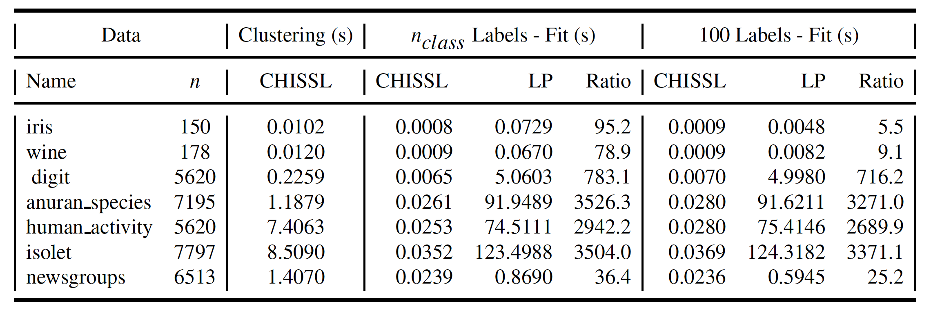
Measuring CHISSL’s Speed Advantage
Speed improvement factor relative to Label Propagation

Slide 13
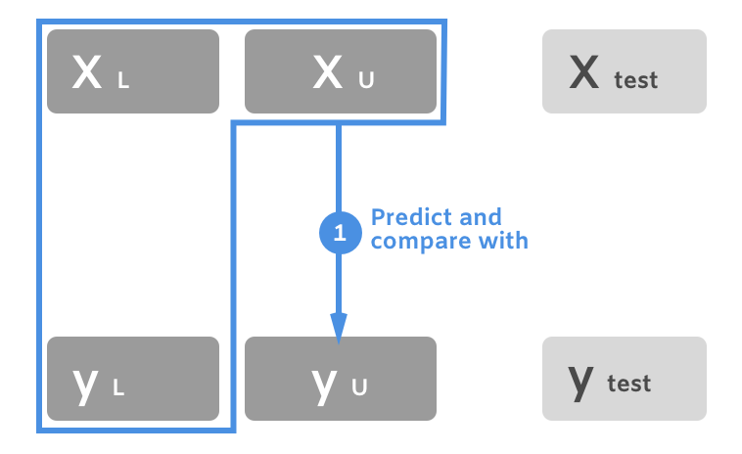
Computational Evaluation—Transduction

Slide 14
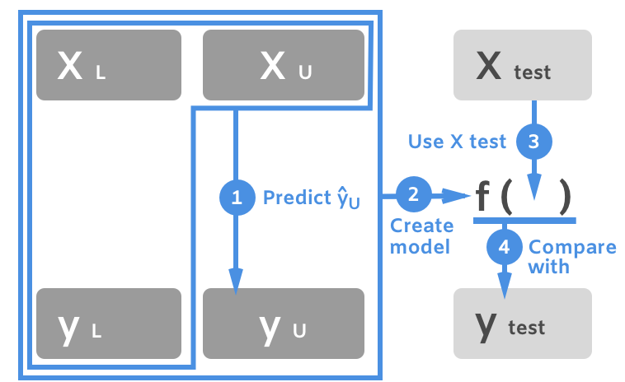
Computational Evaluation—Bootstrapped Induction
Notes:
Train one model to guess the labels, then train another model on those labels—that’s crazy pants!

Slide 15
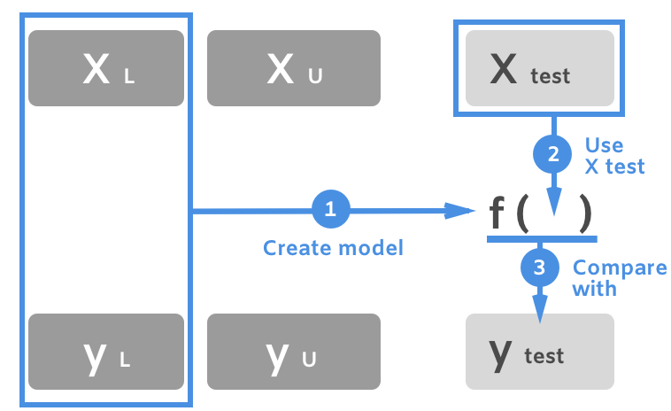
Computational Evaluation—Induction

Slide 16
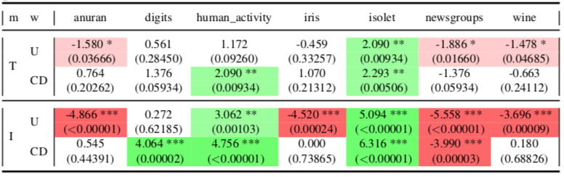
One-Shot Evaluation
Notes:
Against label propagation
U: Uniform
CD Centroid distance
Both green and white are good
We suck at text
We’re way better than supervised, so everything compares against semi-supervised, e.g., label propagation.

Slide 17
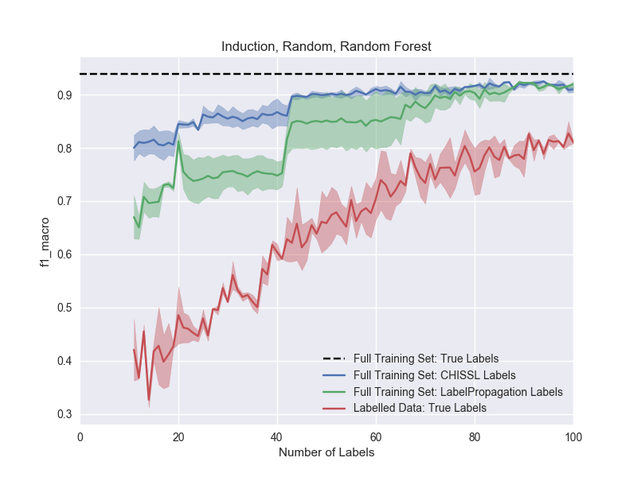
Advanced Evaluation: Oracles and ABC’s
Notes:
Area between curves

Slide 18
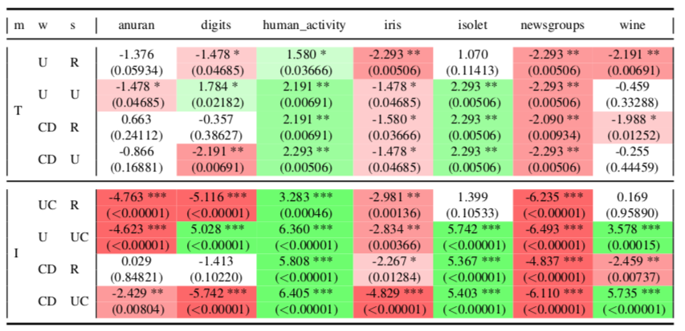
After 100 Total Labels
Notes:
Against label propagation
U: Uniform
CD: Centroid Distance
U: Uncertainty sampling

Slide 19
Summary of Findings
CHISSL is super fast
Conservative estimate including clustering 10x to 1000x speedup
Incremental update takes 1-2ms for 100K instances in web browser
CHISSL frequently outperformed SSL baseline at one-shot learning
Except with text
Cluster weights were helpful
CHISSL sometimes outperformed SSL baseline with 100 labels
Again, except with text
Again, cluster weights were helpful
Uncertainty sampling more harmful for SSL baseline

Slide 20
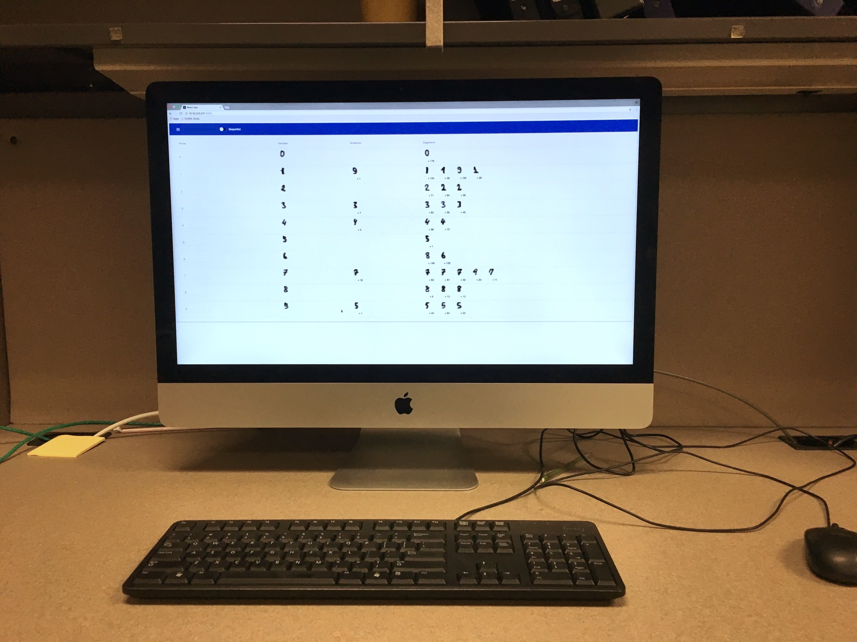
User Study
Context: in-laboratory
Duration: a single 1-hour session
Population: n=25
14 female
15 computer science, 10 social science
Design:
within subjects
{3 datasets} x {Sequential, CHISSL}
Measures:
Annotation accuracy
Transduction accuracy
Number of labels
Post-feedback questionnaire

Slide 21
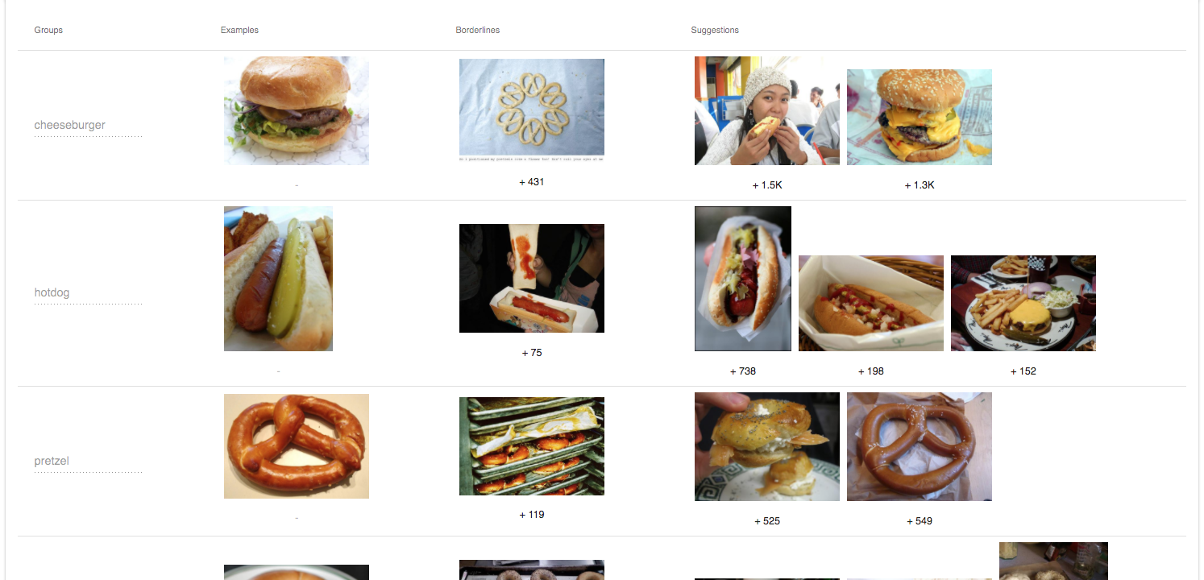
ImageNet Foods—Image Data

Slide 22
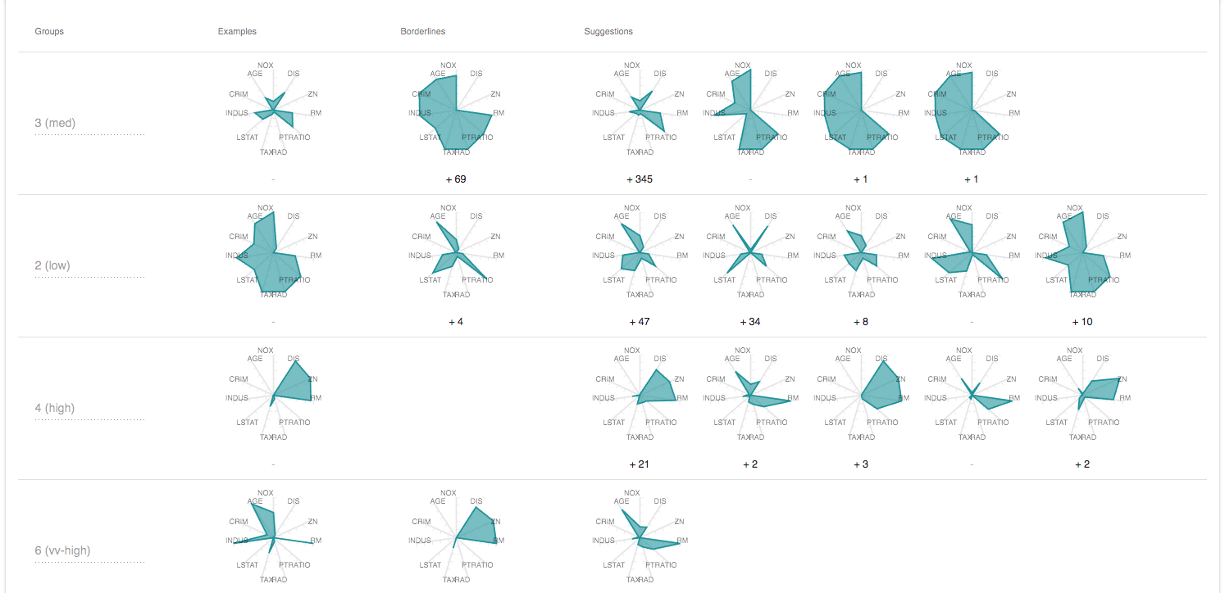
Boston Housing—Structured Data

Slide 23
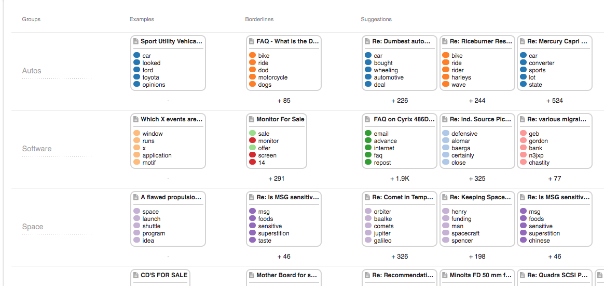
20 Newsgroups—Text Data

Slide 24
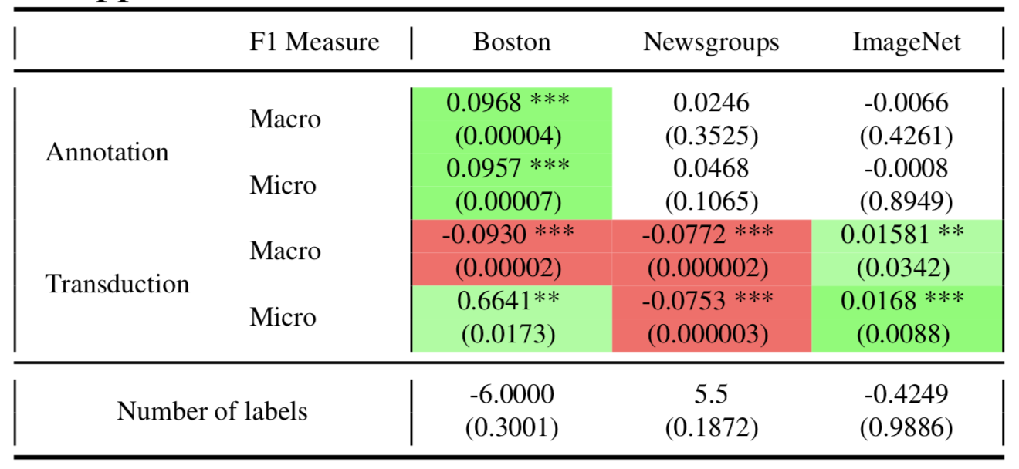
With Real Users—CHISSL vs. Active Learning

Slide 25
User Study Findings
Compared to Active Learning
Participants’ transductions were better with CHISSL on structured and image data
Participants’ transductions were worse with CHISSL
Participants’ annotations were better with CHISSL structured data
Performance differences were smaller for image data
Based on qualitative input
Machine Learning familiarity did not correlate with performance
Text took longer, was harder
Participants enjoyed the study

Slide 26
What’s next?

Slide 27
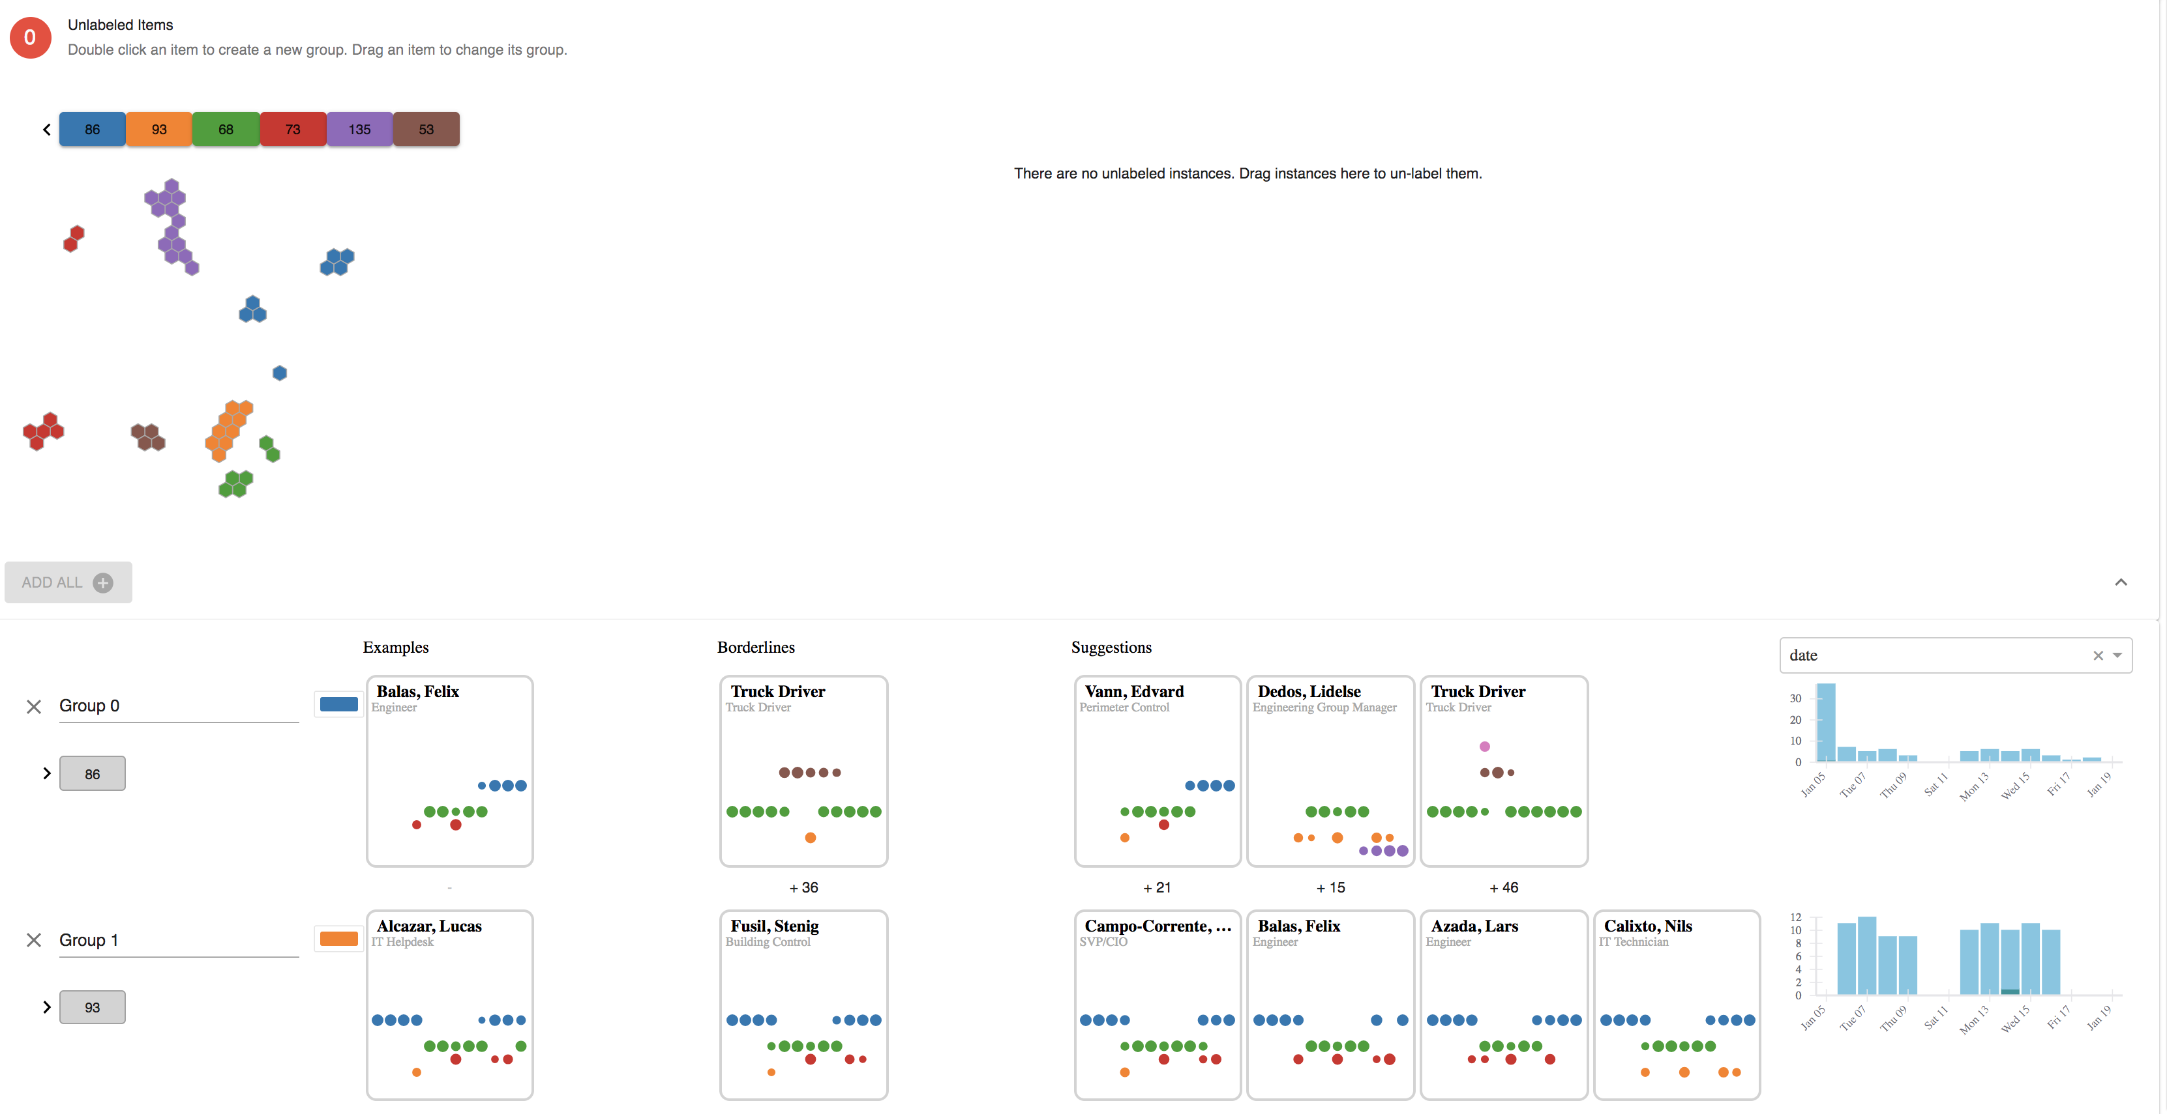
Addressing the Limitations We Discovered

Slide 28
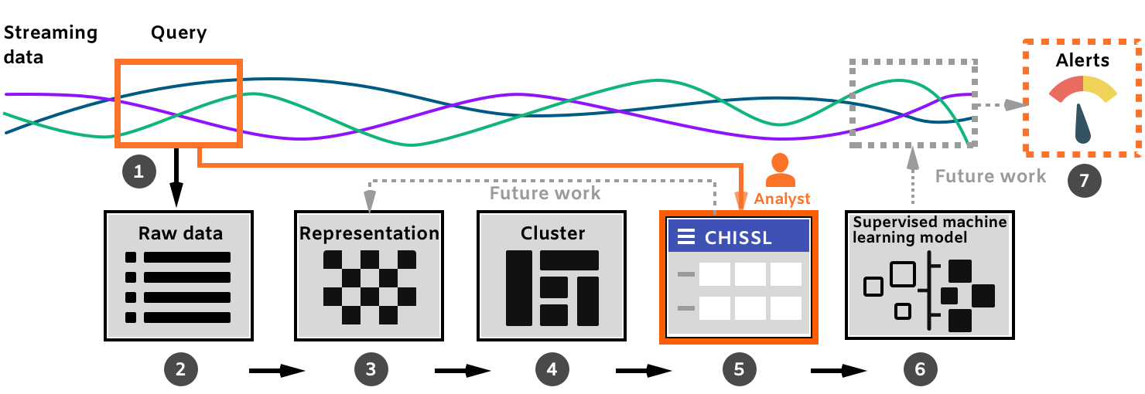
Future Work and the “Big Picture”
Notes:
Show more advanced features in CHISSL.
Throw away models

Slide 29
Really what’s next?
It’s your turn!

Slide 30
Conclusions
Rapid—much faster than baselines
Accurate—better than supervised and competitive with semi-supervised baselines
Helpful—users gave more accurate labels and built more accurate models
Application Domains
Geo-temporal analysis
Insider threat detection
Available on GitHub https://github.com/pnnl/chissl
Dustin.Arendt@pnnl.gov
Notes:
More future work: ensembles & annotator agreement
Thank Emily Saldanha & Svitlana Volkova

